Slide 1
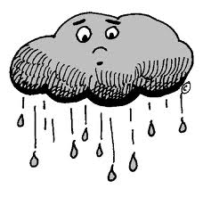
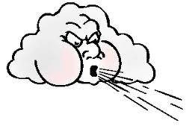
Water and wind
Potential and kinetic energy

Slide 2
Water cycle How many ways can water go up?
Sun adds heat to surface water and it evaporates.
Sun heats the leaves of plants and sucks up huge columns of water which Transpire into the air.
Plants and animals slowly burn stored energy from food and Respire water into the air.
Forest fires and burning of fossil fuels combusts water into the air.

Slide 3
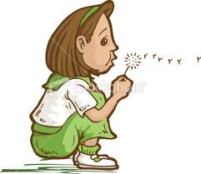
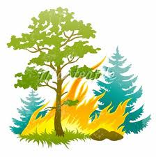
Moving water up creates potential energy
The sun is responsible, it is the driving force of the water cycle. Is it direct or indirect?
Evaporation
Direct
Transpiration
Direct
Respiration
Indirect
Combustion
Indirect

Slide 4
When rain Falls Kinetic Energy
When rain falls
And runoff and infiltration occur
The water does work (It moves things)
E.g.
Erosion
Weathering
Energy in motion is Kinetic energy

Slide 5
Chemical changes in the air during condensation ACID RAIN
Sulfur from smoke + oxygen→ sulfur dioxide
S + O₂ → SO₂
Sulfur dioxide + oxygen → Sulfur trioxide
2SO₂ + O₂ → 2SO₃
Sulfur trioxide + water → Sulfuric Acid
SO₃ + H₂O → H₂SO₄
This also happens with nitrous oxides NOx

Slide 6
Wind Moving air up creates potential energy
Uneven heating of the earth causes air to rise.
Hot air rises
heat spreads particles.
Air becomes less dense.
Floats
Causes low pressure
Uneven cooling of the earth causes air to fall
Cold air falls
Particles are closer together
Air is more dense
Sinks
Causes high pressure

Slide 7
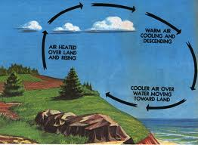
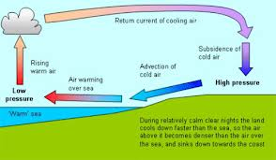
Locally Kinetic wind always blows from Hi’s to Lo’s
On shore breezes
Off shore breezes
Soil cools faster
Air over the soil falls
Breeze blows off shore
From Hi → Lo pressure
Soil heats faster than water
Air over soil rises
Breeze blows onshore
From hi → lo pressure

Slide 8
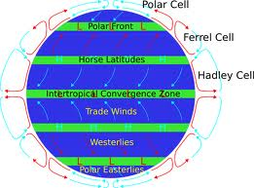
Globally Kinetic Wind always blow from hi’s to lo’s

Slide 9
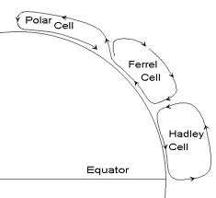
Six convection cells
Sun shines at right angles at the equator
Hot air rises
Sun shines at a steep angle at the poles
Cold air sinks
This causes convection cells

Slide 10
There is low pressure at the equator
And high pressure between
the Hadley and Ferrel Cells.
The wind should go from north to south
It doesn’t
The Earth turns under the air
and displaces it
It looks like it’s going
from the east to the west

Slide 11
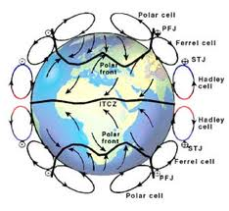
Winds on the surface and the Coriolis Effect

Slide 12
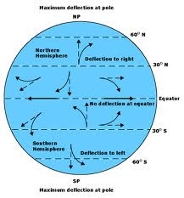
Coriolis affect Kinetic energy
The earth is turning towards the East.
There isn’t a lot of friction so earth slips past the wind
It appears like the wind bends clockwise in the Northern hemisphere.
This is called the Coriolis Effect
It creates prevailing winds

Slide 13
Wind direction.
Winds are named from whence they came.
A North wind comes from the North
“The North wind doth blow and we shall have snow
And what will poor Robin do then, poor thing.
He’ll sit in the barn and keep himself warm
And hide his head under his wing, poor thing
And hide his head under his wing

Slide 14
Regions of no wind Don’t get stuck in the Doldrums where air sinks or rises
0⁰ North latitude Equator
30⁰ North latitude
Tropic of Cancer
60⁰ North latitude Arctic circle
90⁰ North latitude North pole
No wind, Intertropical
convergence zone
No wind, the horse latitudes
No wind,
Polar front
No Wind

Slide 15
Prevailing winds
Between the equator and the horse latitudes
Between the horse latitudes and the arctic circle( our temperate zone)
Between the arctic circle and the north pole
Easterly Trade winds
Sailors sailed east to N.A. To Trade their goods.
Prevailing westerlies
The Gulf stream goes this way too this is how goods were sailed back to England
Polar Easterlies
Nobody sails up here if they can help it.

Slide 16
Read Pages 332- 339 in text
Answer Check point questions
P 333 1-5
P339 1-7

