Slide 1
Vision
Near and far

Slide 2
IN normal vision the image falls on the retina
The light shines through the biconvex lens
It converges, in the focal point in the middle of the eye.
The focal plane or perfect image falls on the retina upside down.

Slide 3
Myopia or Near sightsighted
The eyeball is too long
The focal pane or perfect image falls short of the retina
Far images look blurry
It is corrected with a biconcave lens.

Slide 4
Hypermetropia or Far Sighted
The eyeball is too short
The focal plane or the perfect image falls behind the retina.
Near images look blurry
It is corrected with a biconvex lens.

Slide 5
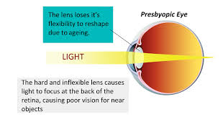
Presbyopia or Far sighted because you are 40
This happens when you get older the lens gets stiffer
The ciliary muscles and ligaments get weaker
It becomes more difficult to focus you lens to read up close.
It is corrected with a bi convex lens.

Slide 7
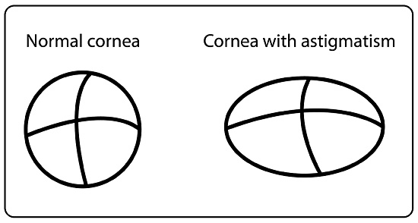
Astigmatism Blurred vision caused by a misshapen cornea

Slide 8
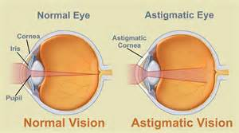

Slide 9
