Slide 1
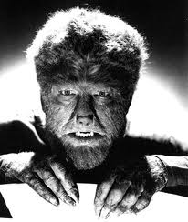

Slide 2
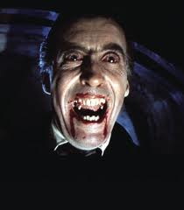

Slide 5
What do these people have in common?
Porphyria

Slide 6
Porphyria
Cause: Cannot make Heme protein in the blood. It is a multi step chemical process that stops partway through. It is an inherited trait.
Symptoms: Skin is very pale. Skin is light sensitive, exposure to sunlight causes rashes. Receding gum line and around nails. Hair on back of hands.
Ancient treatments: fresh blood to replace theirs.
Myth: Vampires and Werewolves

Slide 7
The Skin (your largest organ, 20lbs) Functions
Protects soft inner cells
Shields body from UV rays (melanine)
Excretes wastes ( sweat, salt, urea)
Shields against bacterial infection
Heals wounds
Homeostasis (Balance)
(Insulates from cold, releases heat when too warm)

Slide 8
Makes vitamin D
Keeps you water proof (Keratin)
Prevents fluid loss (Keratin and sebaceous oils)
Makes Hair and Nails (Keratin)

Slide 9
Skin Feelings
Indicates what’s happening (touch, temperature, pressure, pain)
Indicates health (pale when sick)
Shows emotions
Fright -Pale
Embarrassed - Pink
Rage - Red

Slide 10
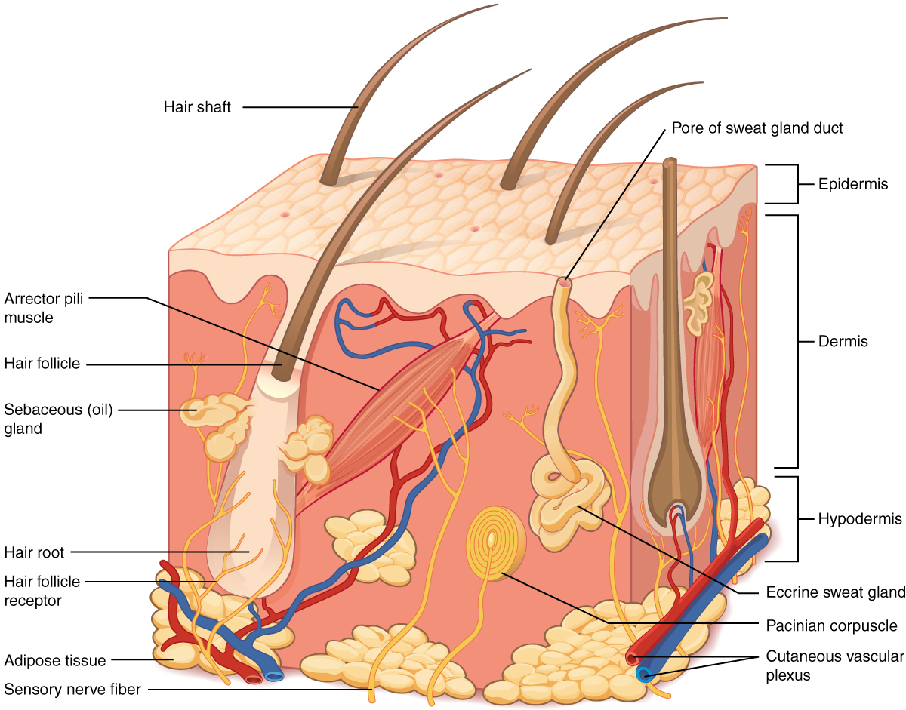
Draw this one

Slide 11
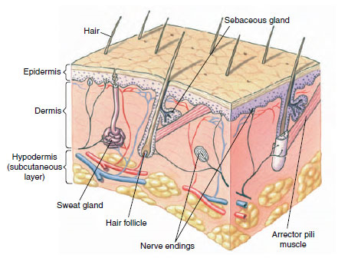
Label this one

Slide 12
Three layers of the skin
Epidermis (above the skin) has 2 parts:
1) stratum corneum or horny layer.
It’s dead and filled with keratin this makes it water proof and tough.
2) stratum germinativum or growing layer
It’s alive and replaces the dead layer as it falls off It’s bumpy to give you fingerprints for gripping.
It makes hair.
Has sebaceous oil glands that moisten your skin and give you zits

Slide 13
Dermis
The dermis (the skin)
Living tissue contains all the blood vessels
The muscles on your hair that make you shiver.
All the sensory receptor for feeling.
All the sweat glands that make you cool

Slide 14
Subdermis (a.k.a. hypodermis or subcutaneous)
Subdermis (under the skin)
Contains fat (Adipose) to keep you warm and give you shape.
It protects major blood vessels and nerves

Slide 15
Draw all the nerve receptors

