Slide 1
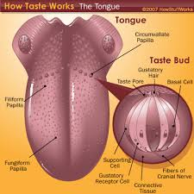
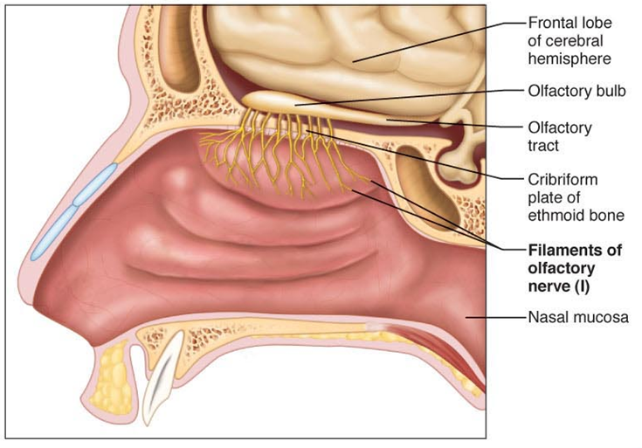
Taste and smell
The gustatory and olfactory systems

Slide 2
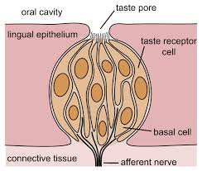
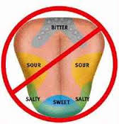
Olfaction or Savour the flavour
Draw 2 diagrams of a tongue and taste bud

Slide 4
Taste
The tongue is covered with bumps called Papillae
The taste receptors are here they are called Taste buds
Sensory hairs can only detect chemical shapes (Tastes) if they are dissolved in saliva
Taste cells are replaced every ten (10) days

Slide 5
There are 5 basic tastes:
Sweet
Salty
Sour
Bitter
Umami
Each of the taste buds can taste several different tastes but some areas of the tongue may be more sensitive to a certain taste.

Slide 6
The fifth taste, Umami, was more recently discovered.
It is a richness of taste and
is associated with fish, sushi, algae, glutamates (MSG)
Savory

Slide 7
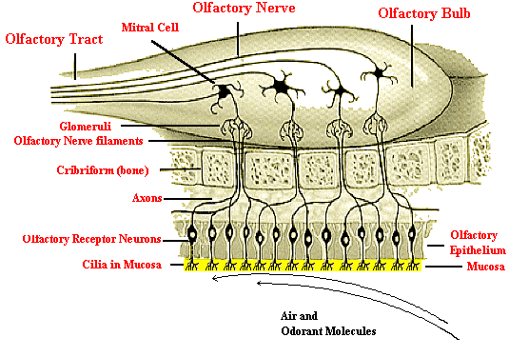
Draw 2 diagrams of the olfactory bulb

Slide 9
Olfaction
Olfaction means sense of smell
Chemicals which we can smell are called odorants.
Smell receptors are found in the olfactory epithelium in the roof of the nasal cavity
These receptor cells must be replaced every 40 to 60 days with new ones

Slide 10
Odorants must be water soluble and fat soluble to dissolve in the mucus that covers the smell receptors.
Cilia on the receptors can detect up to 10,000 different odorants.
Nerves from the olfactory epithelium pass upward s through the sieve-like bone in the skull to the olfactory bulb underneath the brain

Slide 11
The olfactory bulb send the message to the olfactory cortex in the base of the brain. Then onto the centers for :
Memory
Emotion
Odor recognition
Pain is a component of most smells.

Slide 12
Flavour
Flavour Is a combination of Tastes (5) plus Smells (10,000). The odorants float up the pharynx to the nasal cavity and greatly enhance the flavour of the food.
When you have a cold the thick Mucus prevents odorants from reaching the receptors.
That’s why you can’t enjoy your food as well as it’s mostly taste.

