Slide 1
Solutions, concentrations dilutions

Slide 2
Solutions
Homogeneous mixture
Two parts but you can only see one
The solvent does the dissolving
Water is often used.
It is so good it’s called the universal solvent
The solute gets dissolved
Salts or sugars are often used.

Slide 3
Concentrations (Think hard now)
If my glass of lemonade is sweeter than your glass of lemonade, then my lemonade is more concentrated.
Formula for concentration
Concentration = Mass of solute or C= M
Volume of solution V
Units g/L

Slide 4
Volume Conversions often in the lab we measure in mL but to do the math we use L
Going from Litre to millilitres
1 L = 1000 mL
2.5L = 2500mL
0.5 L = 500 mL
Move the decimal 3 places to the right →

Slide 5
Volume conversions
Going from millilitres to Litres
250 mL = 0.25 L
2000 mL = 2 L
50 mL = 0.05 L
Move the decimal three places to the left ←

Slide 6
If you know 2, then you can find the third remember the triangle trick
Find Mass = C x V
Concentration = M
V
Volume = M
c

Slide 7
How do you do word problems?
Given: Mass = ______g
Vol = ______mL or ________ L
Find: Concentration = M
V
Show all your calculations with units
Answer C= ______g/L

Slide 8
Example 1
How is 50ml of a 50g/l solution prepared?
Given: V= 50 mL or 0.05 L
C = 50g/L
Find: Mass= C x V
= 50g/l x 0.05L
= 2.5g

Slide 9
Example 2
20g of solute are dissolved in water to make 0.5L of solution. What will the concentration be in g/L
Given:
M = 20g
V = 0.5L
Find:
C = M/V
Calculations: 20g / 0.5L
Answer: 40g/L
_____40_______ g/L

Slide 10
Example 3
8g of solute were dissolved in water to make __?__liters of solution(Koolaid) with a concentration of 20g/L. How much Koolaid did they make?
Given:
Find:
Calculations:
Answer:
Mass= 8g
Concentration = 20g/L
Volume = M/C
V = 8g/ 20g/L =
V = 0.4 L or 400mL
_0.4___ L

Slide 11
Now it’s your turn
Do work sheet solutions . Show all your Givens and Finds.
Write the formula for each question
Include all the units and show all your work
Put your final answer with the units in a box.

Slide 12
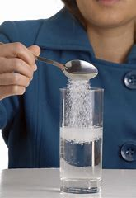
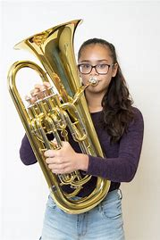
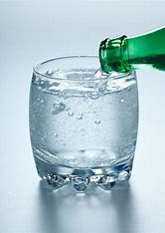
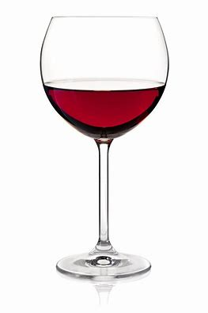
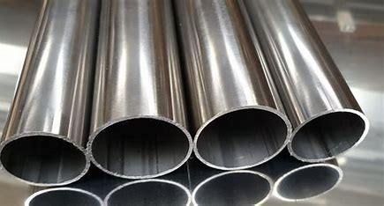
Solutions
Often solutions are a solid dissolved in a liquid. E.g. sugar in water.
But there are other kinds:
Brass carbonated water air wine steel
Copper+zinc H₂O + CO ₂ N₂ +O₂ + H₂O water + alcohol iron +carbon
Solid +solid liquid + gas gas + gas Liquid +liquid solid +solid

Slide 13
% V/V
For these types of solutions we use a different unit called Percent%
How many parts of solute are there in 100 parts of solution.
We use these everyday

Slide 14
% v/v = ml of solute 100ml of solution
They have to list the concentration of the active ingredient.
Milk 2% butterfat v/v
Vinegar 5% acetic acid v/v
Toothpaste .454% fluorine w/w
Wine 12 % alcohol v/v
Beer 5% alcohol v/v
Bugspray 98.11% DEET v/v

Slide 15
% w/w and % vol /vol Use this with a solid in a solid use this when a liquid is dissolved in a liquid toothpaste or Windex
Every day we buy things that are in solution
Milk 2% V/V
Vinegar 5% V/V
Toothpaste .454% W/W
Wine 12%V/V
Beer 5% V/V
Bugspray 98.11% W/W
2ml of butter fat /100ml of milk
5ml of acetic acid/100ml of vinegar
.454g of fluoride/100g of toothpaste
12ml of alcohol/100ml of wine
5ml of alcohol/100ml of beer
98.11mL of deet/100ml of bugspray

Slide 16
These calculations you do in mL
How much alcohol is there in a serving of wine that has a concentration of 12%. A wine glass holds 250 mL
Given: C =12% V = 250mL
Find: Vol of alcohol (solute)
Formula: V solute = C x V solution
Calculations: 250mL x 12% = 30mL
You can also do it this way 0.12 x 250 mL = 30 mL
Answer with units 30 mL of Alcohol

Slide 17
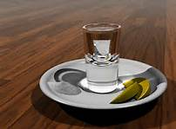
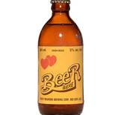
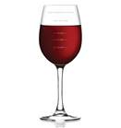
Compare the amount of alcohol in a shot of vodka, a bottle of beer and a glass of wine
V= 600 mL
C = 5%
V = 250 mL
C= 12%
V = 75 mL
C = 40%

Slide 18
Volume of Alcohol = C x V
600 mL x 5% = 30mL
250 mL x 12 % = 30 mL
75 mL x 40% = 30 mL

Slide 19
Now it’s your turn
Do work sheet solutions . Show all your Givens and Finds.
Write the formula for each question
Include all the units and show all your work
Put your final answer with the units in a box.

Slide 20
Dilutions (making it weaker by adding water)
When MS Melanie stores acid and calcium hydroxide she gets a really concentrated form so that it won’t take up much space.
This is C₁ or the initial concentration (highest)
When she prepares it for your labs she doesn’t want you to get hurt so she takes just a little bit and dilutes it so it is safe for you to use carefully.
This is C₂ or the final concentration. (Lowest)

Slide 21
Dilutions
When Ms. Melanie takes just a little bit of the strong concentration. This little bit is
V₁ or your initial volume. (This is how much you start with it’s usually the smaller number.)
Then Ms. Melanie adds extra water (Solvent) to the first little bit.
V₁ + water added= V₂
V₂ or the final volume. ( this is the total amount of solution you end up with,it’s usually the bigger number.)

Slide 22
How to do the math C₁ x V₁ = C₂ x V₂
There is a can of frozen pink lemonade in the freezer. It has a concentration of 35g/L. Nikita really wants some but she knows her mother is saving it for a party. She figures it would be ok if she just made 1 glass (175mL). To be sweet enough it would have to be 10g/L. Her mother would never know it’s missing. How much of the concentrate should she use?
Given:
C₁= 35g/L
C₂= 10g/L
V₂= 175mL or 0.175 L
Find:
V1 = C₂ x V₂ = 10g/L x 0.175 L = 0.05 L
C1 35g/L
or 50 mL

Slide 23
Here’s how you change your formulae C₁ x V₁ = C₂ x V₂
C₁ = C₂ x V₂ V₁ = C₂ x V₂
V₁ C₁
C₂ = C₁ x V₁ V₂ = C₁ x V₁
V₂ C₂

Slide 24
Now it’s your turn
Do work sheet solutions . Show all your Givens and Finds.
Write the formula for each question
Include all the units and show all your work
Put your final answer with the units in a box.

