Slide 1
Solutions and Concentration

Slide 2
Outline
Outline:
Quiz!
Review solutions
What is concentration
More/less concentration
Calculating concentration
Independent/dependent variables

Slide 3
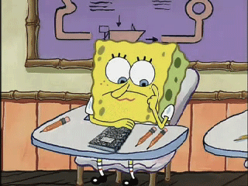
Quiz!

Slide 4
What is a solution?
Homogeneous mixture of solute and solvent
Solute: substance dissolved
Often a solid
Solvent: usually a liquid in which the solute is dissolved
Solution = solute + solvent

Slide 5
Example of a solution
I take a spoonful of Nesquik powder and mix it into my milk to make chocolate milk.
What is the solute?
What is the solvent?
What is the solution?
Nesquik powder
Milk
Chocolate Milk

Slide 6
What is concentration?
The amount of substance within a given volume
$$C=\frac{M}{V}$$
C: concentration (g/L)
m: mass of solute (grams)
V: volume of solution (litres)
Remember: 1 L = 1000 ml

Slide 7
More/less concentrated
What does it mean when something is more concentrated than something else?
Example

Slide 8
More/less concentrated?
1L
m=8g
V=4L
m=2g
V=1L
4L
C= m/V
C=8g/4L
C=2g/L
C=2g/1L
C=2g/L

Slide 9
Variables
Independent variable:
The variable that is controlled
Dependent variable:
The variable that changes in response to the independent variable

Slide 10
Examples of Variables
You are looking at the effect of mass of solute on the concentration of a solution.
Identify the independent and dependent variables.
Independent variable:
Dependent variable:
Mass
Concentration

Slide 11
Practice Problem – Calculating Concentration
1. Hailey made herself 50ml of Kool-Aid by dissolving 2.5g of the powder into water. What is the concentration of the Kool-Aid in g/L?

Slide 12
Practice Problem – Calculating Concentration
2. Jordan is having a party and is making Minute Made juice. He mixes in 100g of the concentrate with some water to produce 2000mL of juice. What is the final concentration (g/L) of the juice?

Slide 13
Percentage
10
10

Slide 14
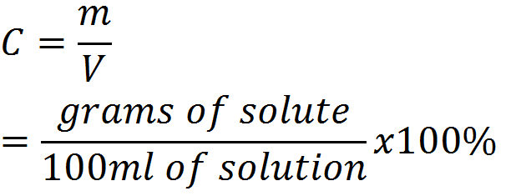
Percent (m/V)
We can also measure concentration in % (m/V)

Slide 15
Percent m/V
100ml of solution
 | 1 ml of water (solvent)
 | 1 g of solute

Slide 16
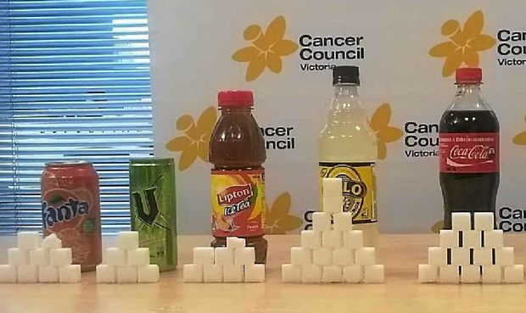
Situation

Slide 17
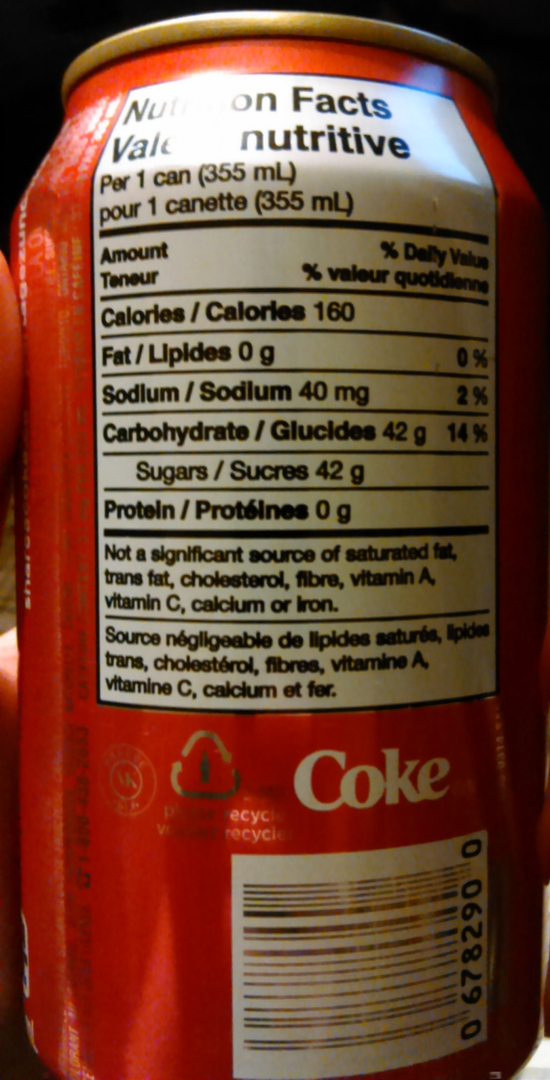
Practice Problem
1. What is the % concentration of sugar in a 355ml can of Coca-Cola?

Slide 18
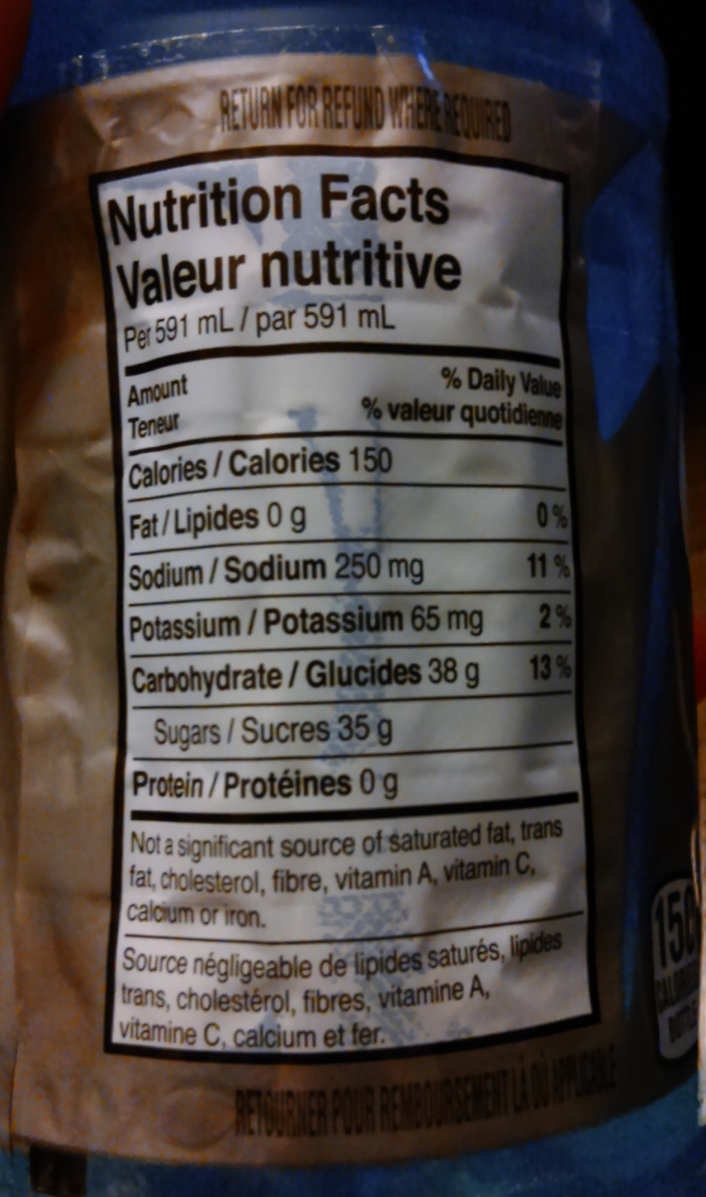
Practice Problem
2. What is the % concentration of sugar in a 591ml bottle of Gatorade?

Slide 19
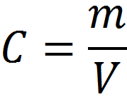
Rearranging the Equation to solve for Mass
m=

Slide 20
Example
Estrella wants to make 125ml of a 8g/L saline solution. How much salt will she need to use?

Slide 21
Rearranging the Equation to solve for Volume
V=

Slide 22
Example
What is the maximum volume that David can make of an 8% solution of chocolate milk if he uses 24g of Nesquik powder?

Slide 23
Worksheets
Work on worksheets:
Solutions I
Solutions II

