Slide 1
SMOKING

Slide 2
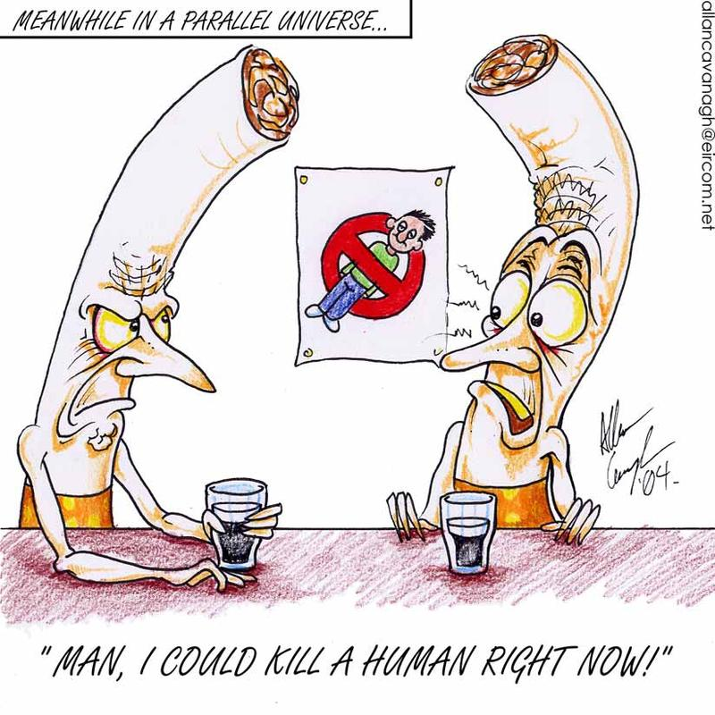

Slide 3
FACTS
In2019 10% of Canadians were smokers.
In 2023 13% of Canadians are smokers
82% of Canadian smokers start between the ages of 14 and 25.
480,000 people die each year in Canada due to smoking related illnesses
Over 41,000 of them from second-hand smoke.
More than five times the number of Canadians who die from traffic injuries, alcohol abuse, murder and suicide combined.

Slide 4
What about Vaping?
E-cigarettes and other vaping products Heat a liquid and turn it into an aerosol to be inhaled into the lungs.
These liquids are: propylene glycol, vegetable glycerine and flavouring. That’s like pouring oil into your lungs.
Flavours have been banned. Blatant advertising to kids.
Many of these substances are considered safe for ingestion (eating); however, when these liquids are heated they create new chemicals that may not be safe to inhale.
For example, the heating process can create chemicals like formaldehyde and other contaminants such as nickel, tin and aluminum. They cause permanent lung damage.
These liquids are a vector to carry nicotine or other substances into the lungs. 1 Juul pod can contain tbe same amount of nicotine as 20 cigarettes.

Slide 5
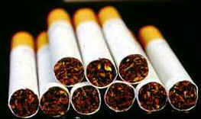
WHAT DO CIGARETTES CONTAIN?
Over 4000 chemicals
60 carcinogenic chemicals
Nicotine - powerful mood-altering substance that is extremely toxic and addictive

Slide 6
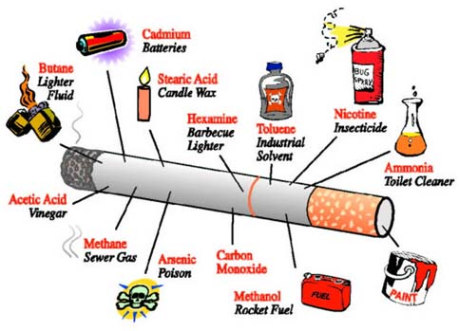

Slide 7
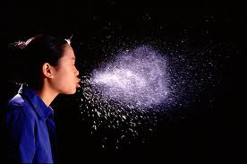
Is it true second hand smoke is bad for you?
Yes!
When you breath second hand smoke much of it is coming off the other end of the cigarette and is not filtered.
Smokers are at a higher risk for colds , flus and other respiratory diseases.
When the smoker exhales you not only get the smoke but also the extra germs.

Slide 8
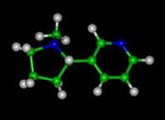
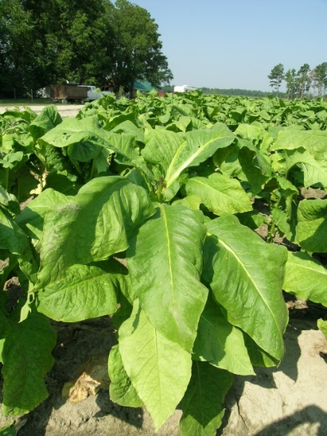
NICOTINE – WHAT IS IT?
Is a base (that’s like a drain cleaner) that is stored in your brain.
When you do things that make you body more acidic it neutralizes the nicotine and makes you crave more.
This is why people often smoke a cigarette after they eat, drink coffee or alcohol, exercise, or have sex.
Found only in the tobacco leaf.
At low doses, it stimulates nerve cells.
At high doses, it is a poison often used as an insecticide.
It is highly addictive and very hard to quit.

Slide 9
Diseases caused by cigarette smoking
Cancer (Lung, throat, tongue, mouth)
Emphysema (The alveoli burst and you don’t have enough surface area to get oxygen.)
Asthma the bronchioles contract and restrict the air space. It’s hard to exhale.
Bronchitis inflammation of bronchi and bronchioles

Slide 10
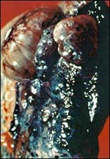
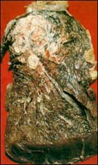
Lung cancer
emphysema

Slide 11
OTHER EFFECTS OF SMOKING ON HEALTH *Smoking makes the following happen faster and more frequently*

Slide 12
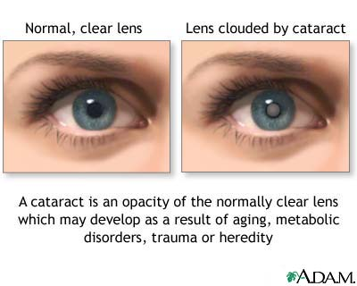
EYES
→Cataracts
→Blindness

Slide 13
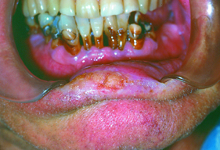
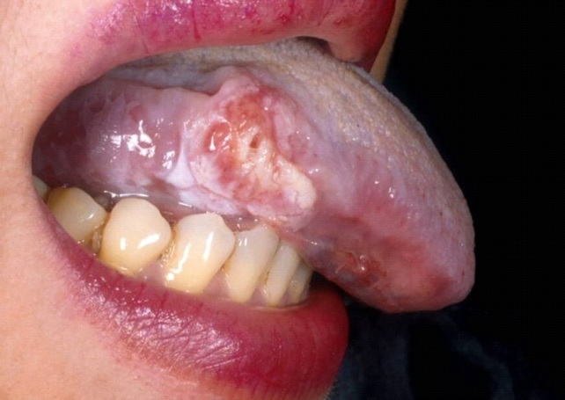
MOUTH
→Bad breath
→Gum disease
→Tooth Decay
→Tongue Cancer
→Mouth Cancer

Slide 14
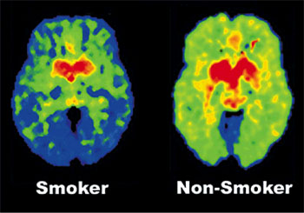
BRAIN
→Nicotine is addictive, it alters the brain
→It increases risk for stroke

Slide 15
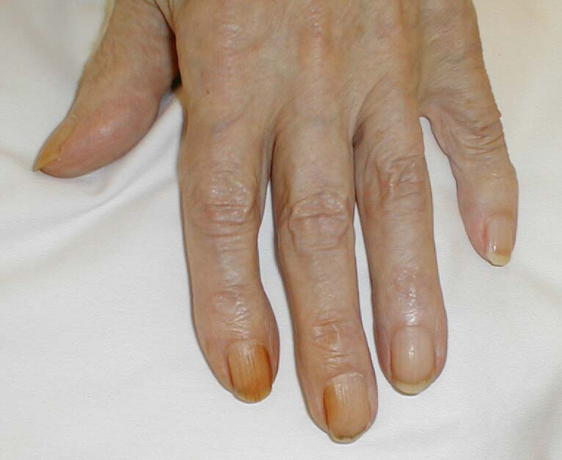
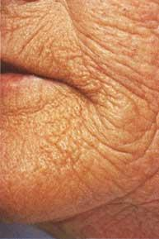
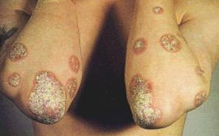
SKIN DAMAGE
→Wrinkles
→ Dry skin
→ Yellow fingers
→ Stained fingernails

Slide 16
Heart Disease
High blood pressure
Constricted blood vessels
Lack of oxygen to blood
Build up of carbon monoxide

Slide 17
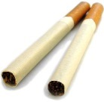
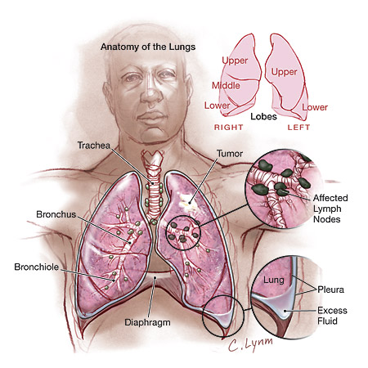
How do we get lung cancer?
Inhibits and damages the normal cleaning process by which the lungs get rid of foreign and harmful particles
Smoke destroys an important cleansing layer in the lungs, which in turn causes a build-up of mucus
Result is "smokers' cough”
Cancer-producing particles in cigarette smoke are able to remain lodged in the mucus and develop into cancer tumors.

Slide 18
LUNG CANCER
Caused when some of the cells forming the tissues of the lungs grow abnormally and form a malignant tumor. The tumor might start in different parts of the lungs.
Rarely noticeable symptoms in the early stages of lung cancer
In later stages, symptoms include:
- A persistent cough that gets worse over time;
- Coughing up blood or increased amounts of mucus;
- Constant chest pain;
- Shortness of breath, wheezing or hoarseness;
- Repeated bouts of pneumonia or bronchitis;
- Swelling of the neck and face;
- Appetite loss, weight loss and fatigue.

Slide 19
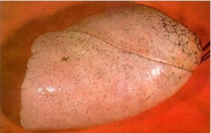
HEALTHY LUNG
You can see how the lung looks without the effects of inhalation of smoke.
Note black specks throughout indicative of carbon deposits from pollution.

Slide 20
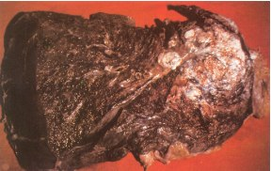
CANCEROUS LUNG
Smokers lung with cancer. White area on top is the cancer, this is what killed the person. The blackened area is just the deposit of tars that all smokers paint into their lungs with every puff they take.

Slide 21
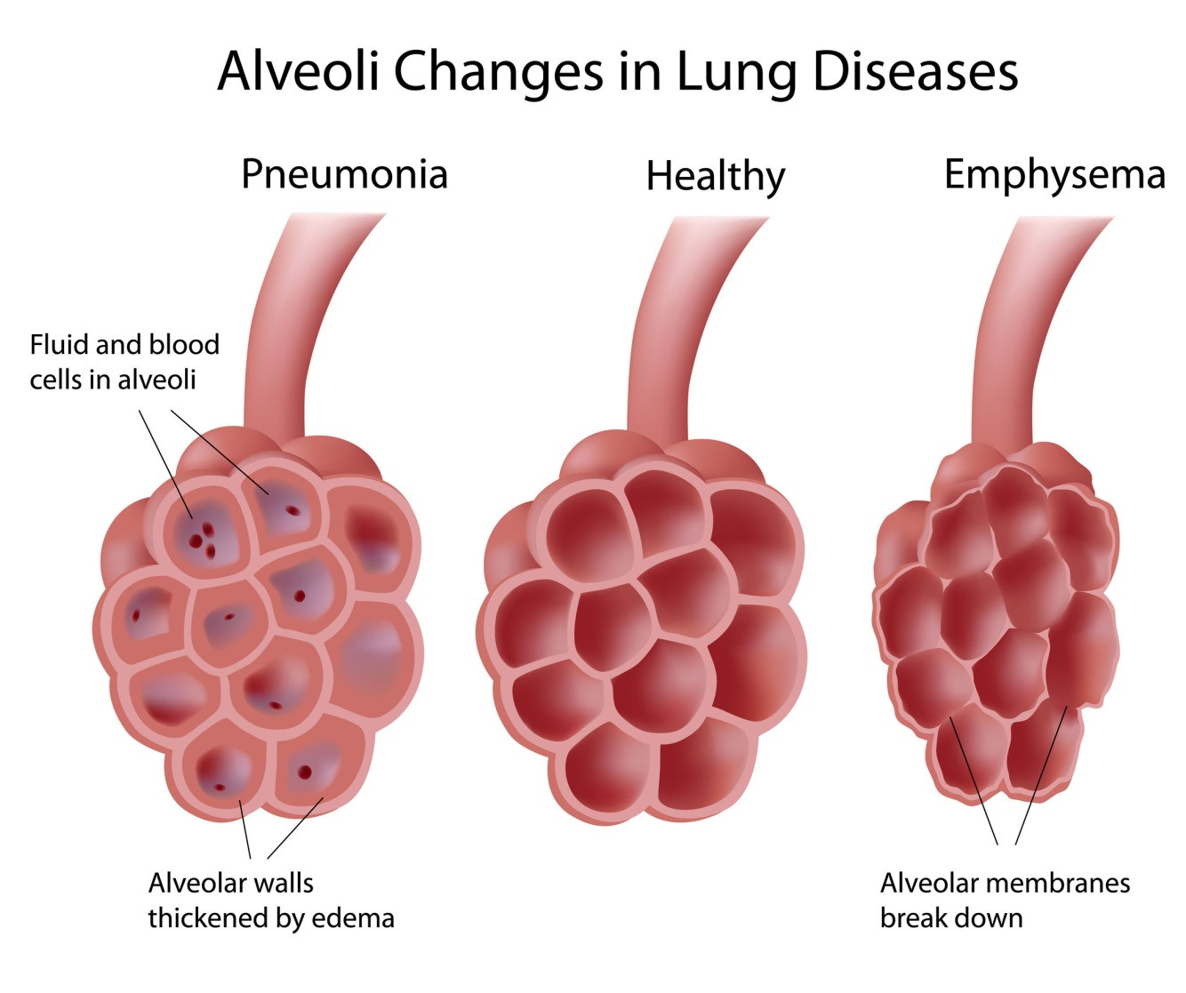
EMPHYSEMA
Chronic (long-term) lung disease
Damage to the air sacs in the lungs

Slide 22
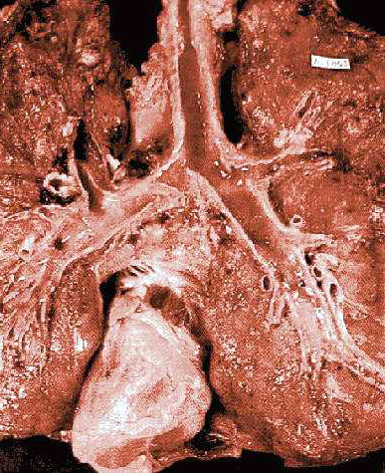
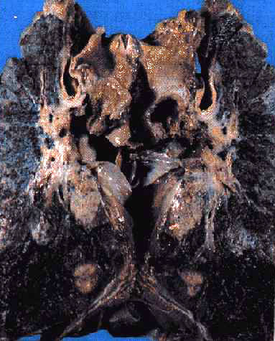
HEALTH EFFECTS
LUNG DISEASES
Healthy Lung
Diseased Lung
Emphysema
Cancer

