Slide 1
Excretion Review

Slide 2
Urinary System | Waste Elimination | Concentration | Definitions | Random
100
100
100
100
100
200
200
200
200
200
300
300
300
300
300
400
400
400
400
400
500
500
500
500
500

Slide 3
What waste product do the kidneys produce?

Slide 4
Urine
Home

Slide 5
How does your urinary system increase and decrease the concentration of your blood?

Slide 6
It increases concentration by urinating and getting rid of excess water
It decreases concentration by conserving water and signalling to the brain that you are thirsty
Home

Slide 7
What three substances does the urinary system get rid of?

Slide 8
Excess water, salts, and nitrogen.
Home

Slide 9
Name the parts of the urinary system in order (the exit point should be last).

Slide 10
01. Kidneys
02. Ureters
03. Bladder
04. Urethra
Home

Slide 11
Why does it take intense concentration to stop yourself from peeing when your bladder is full?

Slide 12
The urethra is controlled by two muscles, and only one of them voluntary, skeletal muscle. The other muscle is smooth muscle that you cannot control.
Home

Slide 13
What waste product is excreted through the skin?

Slide 14
Sweat
(containing salt, ammonia, and excess water)
Home

Slide 15
Which two gases are exchanged in the respiratory system, and which of them is waste?

Slide 16
Oxygen and carbon dioxide (which is waste)
Home

Slide 17
Which three structures in the body function in waste elimination?

Slide 18
Kidneys
Sweat glands
Lungs
Home

Slide 19
Name four substances that can be considered waste that your body needs to get rid of.

Slide 20
Carbon Dioxide
Water
Salt
Ammonia (Nitrogen)
Home

Slide 21
Once carbon dioxide waste has left the lungs, name the parts of the path it takes to exit from the mouth.

Slide 22
Bronchi
Trachea
Larynx
Pharynx
Mouth
Home

Slide 23
What units are commonly used to measure concentration?

Slide 24
Grams per litre
(g/L)
Home

Slide 25
Define the terms solute and solvent.

Slide 26
Solute: a substance that gets dissolved and is present in a smaller quantity.
Solvent: a substance into which another dissolves and is present in the largest quantity.
Home

Slide 27
What three factors can affect the solubility of a substance?

Slide 28
Temperature
Pressure
Nature of the substance
Home

Slide 29
If 3.9g of Kool-Aid is dissolved in 2L of water, what is the concentration?
(show formula, units, and all work)

Slide 30
C = m/v
C = 3.9g / 2L
C = 1.95 g/L
Home

Slide 31
If you have 3L of solution with a concentration of 5g/L, and you add 1.5L of water to it, what is the new concentration?
(Show formula, units, and all work)

Slide 32
C1V1 = C2V2
(5g/L)(3L) = C2(3L+1.5L)
15g = C2(4.5L)
C2 = 15g/4.5L
C2 = 3.33 g/L
Home

Slide 33
What is excretion?

Slide 34
Excretion is the process by which your body gets rid of metabolic waste.
Home

Slide 35
What is metabolism and what does it produce?

Slide 36
Metabolism refers to all the chemical reactions that take place in your body that keep you alive.
It produces waste products that need to be eliminated.
Home

Slide 37
What is meant by each of the following terms?
Unsaturated
Saturated
Supersaturated

Slide 38
Unsaturated solutions contain less than the maximum amount of solute that could be dissolved.
Saturated solutions contain the maximum amount of solute that can be dissolved.
Supersaturated solutions contain more than the maximum amount of solute that can normally be dissolved, which often requires heating.
Home

Slide 39
Define dilution (in terms of solute and solvent) and describe how dilution of the blood occurs in the human body.

Slide 40
Dilution is the process of decreasing the concentration of a solution by adding solvent.
The amount of solute stays the same.
Your kidneys dilute your blood by conserving water and signalling to the brain that you are thirsty.
Home

Slide 41
Define the following terms:
Heterogeneous
Homogeneous
Solution
Colloid
Concentration

Slide 42
Heterogeneous: a mixture in which you can see the different particles that make it up with your eyes.
Homogeneous: a mixture in which you can’t see the different particles that make it up with your eyes.
Solution: a homogeneous mixtures in which a solute dissolves in a solvent.
Colloid: a homogeneous mixture in which you can see the different particles that make it up by using a microscope.
Concentration: the amount of solute dissolved in a solvent.
Home

Slide 43
Which system in the body collects extra-cellular fluid from around cells and cleans it before returning it to the circulatory system?

Slide 44
The lymphatic system
Home

Slide 45
Which two systems work together to feed oxygen to the cells of the body?

Slide 46
The respiratory system and
the circulatory system
Home

Slide 47
Name the three different types of muscle.

Slide 48
Skeletal muscle
Cardiac muscle
Smooth muscle
Home

Slide 49
When blood enters the heart through the vena cava, what are the names of the four chambers that it goes through (in order)?

Slide 50
Right atrium
Right ventricle
Left atrium
Left ventricle
Home

Slide 51
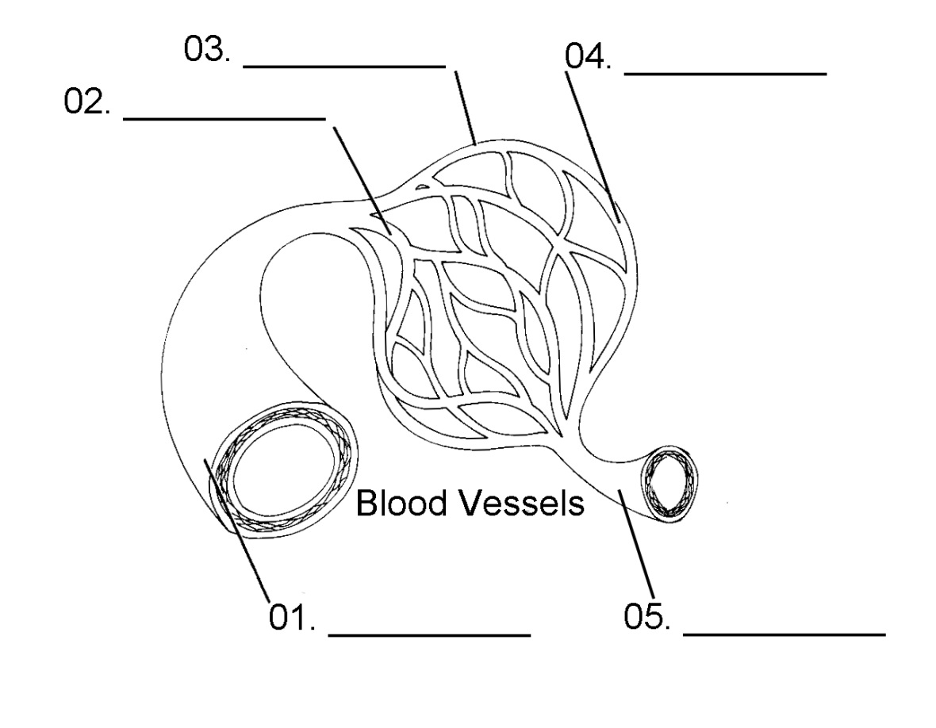
Name the parts in the diagram below:

Slide 52
01. Artery
02. Arteriole
03. Capillary
04. Venule
05. Vein
Home

