Slide 1
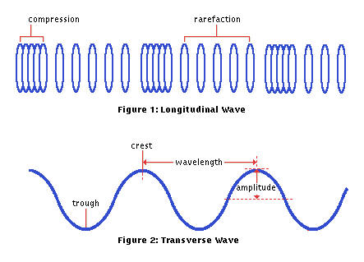
Review of waves

Slide 2
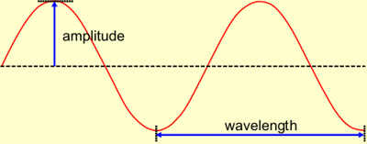
Light and sound travel as waves
Waves can be described by their amplitude, wavelength and frequency.

Slide 3
Amplitude
The amplitude of a wave is its maximum height from its rest position.
The amplitude of a light wave is its brightness
The amplitude of any electromagnetic wave is its intensity.

Slide 4
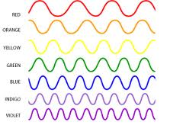
Wavelength
The wavelength of a wave is the distance between a point on one wave and the same point on the next wave, eg. crest to crest.
Wavelength of light is it’s colour.

Slide 5
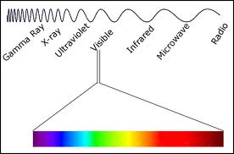
Colour
RED has the longest wavelength.
Violet has the shortest wavelength
Outside of these limits “light” would be invisible to the eye

Slide 6
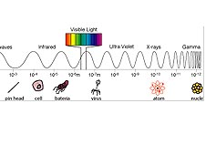
Electromagnetic radiation
Wave length determine what type of wave it is. From long to short they are:
Radio waves, microwaves, heat waves, visible light, ultraviolet, x-rays, gamma rays.

Slide 7
Shorter waves
Carry more energy and can penetrate through stuff. But they can’t travel very far.
Long waves carry less energy, they can’t penetrate stuff. But they can travel far

Slide 8
Frequency
The frequency of a wave is
The number of waves passing by in one second.
The unit of frequency is the hertz (Hz)
Frequency and wavelength are related.
Shorter wavelength mean higher frequencies.
Longer wavelengths mean lower frequencies

Slide 9
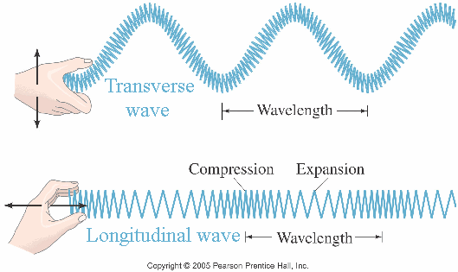
Two types of waves
Transverse waves
Compression waves

Slide 10
Transverse waves
Light and the electromagnetic spectrum use these wave.
Because they are not made of vibrating particles they can travel through a vacuum. They do not need a medium. So they travel through space.
They are very fast 300 000 000 m/s in the air

Slide 11
Compression or longitudinal waves
Sound waves are like this.
Compression waves must travel through a substance (solid, liquid, or gas) called a medium.
One molecule hits another molecule, which hits another, passing energy along.
Because sound waves depend on moving objects (molecules) they are not very fast.
Less than 350 m/s in the air

Slide 12
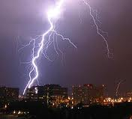
This is why you see the lightening
Before you hear the thunder

