Slide 1
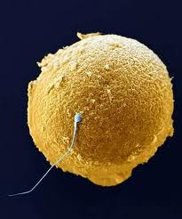
Reproduction and artificial reproductive technologies
How to make eggs and sperm
What to do if you are having trouble conceiving a baby

Slide 2
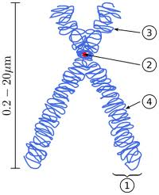
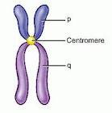
Chromosomes
Chromosomes are tightly coiled up DNA
They are coiled up to make it easy to divide

Slide 3
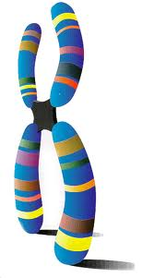
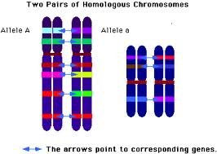
Genes
Genes are short sections of DNA that code for a protein or a trait . For example...
Insulin, eye colour, dimples, attached earlobes

Slide 4
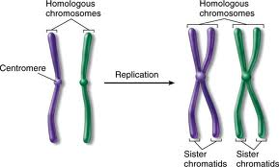
Meiosis
You get half your genes from your mother and half your genes from your father.
You have 2 copies of each of your chromosomes.

Slide 5
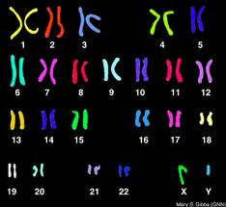
Karyotype
Every cell has 23 pairs of chromosomes.
This is called a
Karyotype

Slide 6
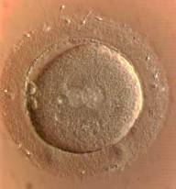
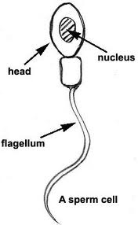
If you are making eggs
and sperm
you have to divide the # of chromosomes in half or the baby will have too many chromosomes

Slide 7
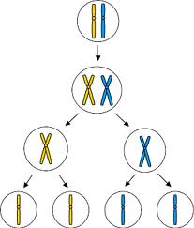
Meiosis
This is the special cell division that cuts the number of chromosomes in half
It’s how you make eggs and sperm

Slide 8
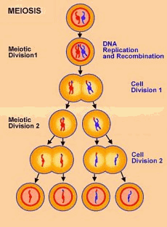
Begin with 1cell
with 2 sets of
chromosomes
End with 4 cells
with 1 copy of
each chromosome

Slide 9
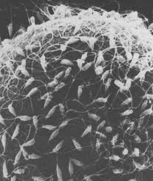
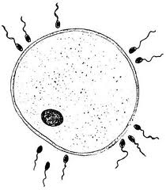
Eggs are much bigger than sperm

Slide 10
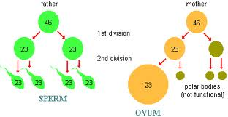
The egg has to nourish the embryo so it hogs all the cytoplasm

Slide 11
Spermatogenesis
Occurs in the testes starting at puberty
It continues for life.
Every meiotic division makes 4 sperm
Meiosis is the opposite of
fertilization

Slide 12
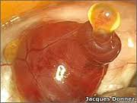
Oogenesis
Occurs in the ovaries
At birth all the eggs have been made
they are stored in the ovary
They mature and one is released each month starting at puberty.
This is called ovulation
This stops at menopause

Slide 13
Gametes
Eggs and sperm are special cells that contain half the number of chromosomes.
They are called gametes
They are made by meiosis.

Slide 14
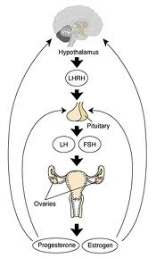
Hormone cycle and ovulation
Your brain is your
biggest sex organ
The pituitary makes
2 hormones: FSH and LH
Follicle stimulating hormone
Luteinizing hormone
They stimulate:
egg and sperm production
male and female hormones

Slide 15
Estrogen, progesterone and testosterone
Female hormones
Male hormones
Estrogen
Progesterone
1⁰ sexual characteristics
^{Ovaries mature}
^{Menstrual cycle begins}
2⁰ sexual characteristics
Breasts, hips, pubic hair, psychological changes.
Testosterone
1⁰ sexual characteristics
^{Testicles mature}
^{Sperm production begins}
2⁰ sexual characteristics
Facial hair, deep voice, bone density and muscle growth, pubic hair, psychological changes.

Slide 16
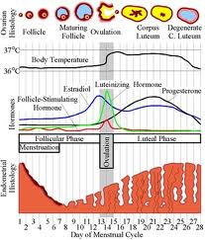
Menstrual cycle

Slide 17
Hormone switches
Pituitary senses the falling progesterone and estrogen in the blood and switches on LH and FSH
FSH tell the ovaries to produce Estrogen
The follicle ripens with the egg
LH, FSH, Estrogen peak.... Ovulation occurs
Follicle becomes a corpus luteum and makes progesterone.
Progesterone peaks corpus luteum shrivels, progesterone levels fall and we start all over again.

Slide 18
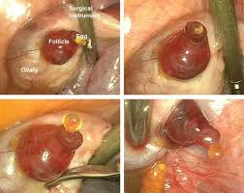

Slide 19
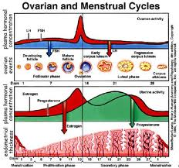

Slide 20
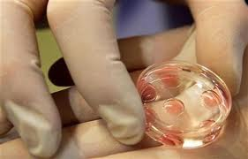
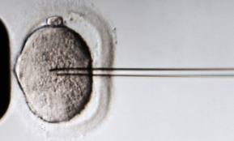
Artificial Reproductive Technologies A.R.T.’s
Hormone therapy: Stimulates the production of several eggs at once so they can be harvested
In vitro fertilization: Eggs and sperm are harvested . Fertilization occurs in a petri dish

Slide 21
Other ART’s
Hormone therapy
Tubular recannulization
In vitro fertilization
Artificial insemination
Intra-fallopian fertilization
Tubal ligation reversal
Egg donations
Surrogate mothers
Testicular biopsy
Aspiration of sperm
Vasectomy reversal
Sperm donation

Slide 22
Infertility
The inability to conceive after trying regularly for 2 years.
Infertility is an issue now. Who pays for ART’s?
In Canada 1 in 10 people have trouble conceiving.
Is it a freedom or a right to conceive
If it’s a freedom you pay
If it’s a right the government pays
If the government pays are their any restrictions?

Slide 23
What’s in the news today
In 2010 the government decided to fund IVF (invitro fertilization)
It was very successful
In 2015 they can’t afford to fund it publically any more.
They are trying to limit the age for IVF and make people pay up front then apply for a tax rebate. This limits who can afford it. ($10,000)
In 2017 they are now able to take regular skin cells and change them into eggs and sperm. So far it’s only been done in mice. There are a lot of ethical repercussions

