Slide 1
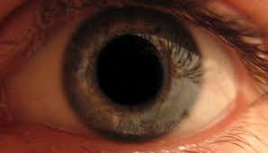
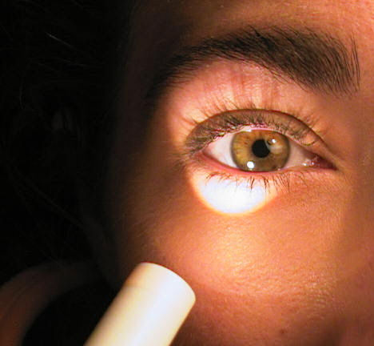
Reflexes of the eye
A Day in the life of an eye ball

Slide 2
Pupilary reflex
Type of reflex
Personal example
Near /Far
You look far away pupil is big
You look up close the pupil is small
Light/ Dark
In bright light your pupils get smaller, so less light will get in
In dim light your pupils get bigger to let in more light.
Love/Hate
Your pupils get big when you look at someone you have a crush on.
They get small when you look at someone you dislike
Near/Far
You look at the board pupil is big.
You look at you paper, pupil is small
Light/ Dark
Love/Hate

Slide 3
Retinal reflex
Reflex
Personal example
Adaptation
In bright light your retina uses the cones
In dark light your retina uses the rods
It takes about ten seconds to switch from one to the other
You are playing outside in the snow and you come inside and it’s so dark it’s hard to see but after a few seconds it seems normal again.
You are at a matinee movie and you come outside into the sun. It’s so bright it hurts your eyes. But then you get used to it.

Slide 4
After images
Negative after images
Look at a bright colour that cone bleaches out.
When you look at a paper you see the opposite colour.
Positive after images
Look at a bright light
Close your eyes and you can still see them. Your retina is over stimulated and keeps firing
Personal examples
Look at red for a long time then look at a white paper. You see green

Slide 5
Peripheral vision
Peripheral vision
If you are looking straight ahead but can still see something beside you.
Movement vs colour
Most of your retina is covered with rods so you can see movement first.
Your cones are only in the middle. You can see movement before colour
Personal examples

Slide 6
Reflexes with 2 eyes
Binocular vision
your left eye sees a slightly different picture from you left eye.
Your brain sees these Two images and interprets them as 3D
Blind spot
Each eye has a blind spot where the optic nerves leave the eyes.
There in different places in each eye. As long as you have two eyes one sees what the other misses
Personal example
It’s hard to thread a needle with just one eye.

Slide 7
Near point accommodation
convergence
Personal Example
When you look at something up close your medial rectus muscles bend your eyeballs together.
When you look far away the muscles relax and your eyeballs are parallel
You can hold your arm up and cover the moon with your thumb.
But the brain knows one is close and the other is far because it feels the muscles move.

Slide 8
A day in the life of an eyeball
You use these 10 reflexes hundreds of times a day.
Make a comic strip of a eyeball going though a day (First person narrative)
Use your personal examples to explain all ten reflexes.
Total mark on 15
1 point for each correct reflex 5 points for story and presentation.

