Slide 1
Lymphatic system
Plasma, Interstitial Fluid, Lymph
Same stuff different place
An Alternate circulatory systm

Slide 2
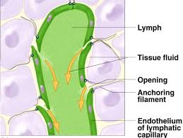
Parts of the lymph system
Lymph capillaries
Are dead ends
They have little
Valves that uptake
Interstitial fluid

Slide 3
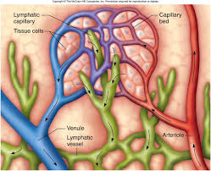
Lymph Capillaries
Lymph capillaries surround cells and capillaries and absorb interstitial fluid.

Slide 4
Lymph nodes
These filter the lymph
Produce white blood cells .These destroy any bacteria
They are located in the groin, neck, armpit, Tonsils, thymus, spleen, and wall of the intestine
It carries the Lymph in lymph vessels (Tubes)
Lymph moves using muscle contraction in the legs and arms (just like veins ).

Slide 5
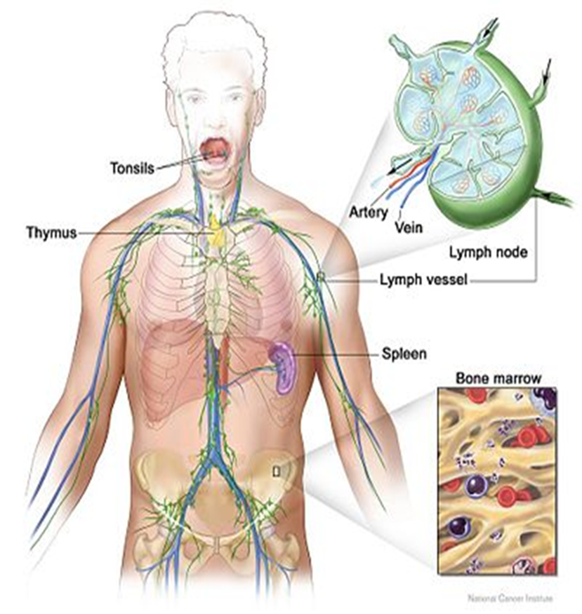

Slide 6
It returns the lymph back into your circulatory system

Slide 7
Close to your superior vena cava

Slide 8
The circulatory system and lymphatic system work together

