Slide 1
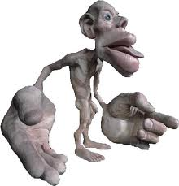
Intro to the senses

Slide 2
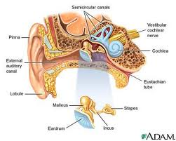
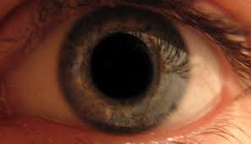
The Senses and Why do we need them?
They receive information from the world around us.
They protect us from harmful things
They attract us to helpful pleasant things

Slide 3
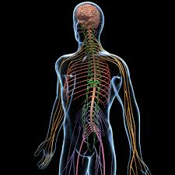
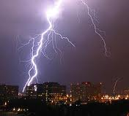
They are part of the Periferal nervous system or PNS
They take energy or chemicals and change them into electrical signals.
All the messages are carried to the brain or CNS for interpretation.

Slide 4
Each sense has 3 parts:
The receptor. This receives the energy or chemical signal and changes it into an electrical nerve impulse.
The transmitter. This is the nerve that carries the message to the brain.
The interpreter. Different parts of the brain interpret for different senses.

Slide 5
Sense Organ Sensor Energy Sensations
Sight Eye Retina Light, colour, shape, (rods and cones) brightness, movement, 3D
Hearing Ear Cochlea Sound pitch, volume, tone
(hair cells) Quality, vibrations balance
Touch Skin Sensors Pressure, heat, cold, pain, (many different ones) textures, light and hard pressure
Smell Nose Olfactory Chemicals hundreds of odors, (Hair cells) pain
Taste Tongue Taste Buds Chemicals sweet, salt, sour, (Hair cells) bitter, Umani

Slide 6
Your turn think outside the box
What do you use for the following senses?
Sense of Direction?
Sense of Balance?
Common Sense?
Sense of Humor?
What senses are being used when someone Hurts your “Feelings”?

