Slide 1
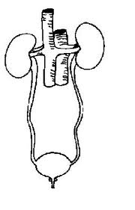
Excretory system
Points to ponder about pee
Or
Test next class and if you don’t study you’re in urine

Slide 2
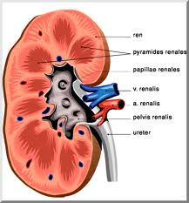
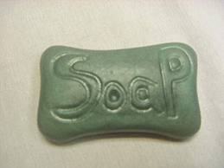
Interesting Facts:
1.The kidneys are about the size of a small bar of soap.

Slide 3
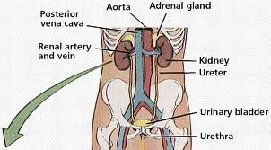
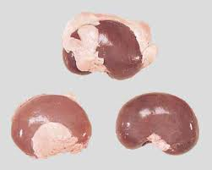
2. The kidneys are behind the liver and under the last two ribs for protection.
3. They are surrounded by fat.

Slide 4
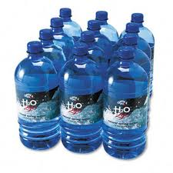
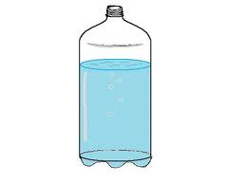
4. ¼ of your entire blood supply goes through the kidneys every minute.
5. In 24 hours it filters 150 - 180 litres of blood.
6. In 24 hours you only make 1 - 1.8 L of Urine.

Slide 5
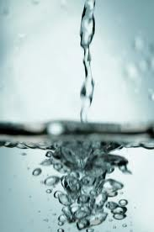
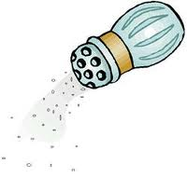
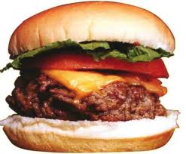
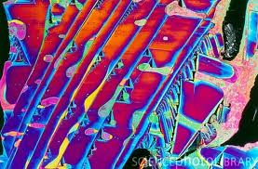
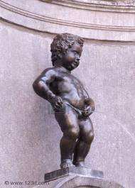
Main Job of the Kidneys:
Maintain water and salt balance.
Eliminate Nitrogen wastes.
Helps maintain blood pressure.

Slide 6
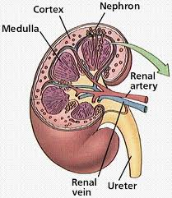
Kidney
Structure
Function
Renal Capsule
Cortex
Medulla
Calix and Renal Pelvis
Ureter
Bladder
Urethra
Tough outer “skin” that protects the kidneys
contains most of the Nephron(Bowman’s capsule and twisted tubules Filters the blood
Inside the cortex. Contains the Loop of Henle. Reabsorbs water and salt. Carries urine to the Calix.
Collects urine and carries it away to the Ureter
2 tubes that drain the kidneys into the Bladder
A muscular sac that stores urine and stimulates the urge to pee when it contains ½ to 1 litre of urine.
A Tube that empties the bladder, to eliminate wastes from the body.

Slide 7
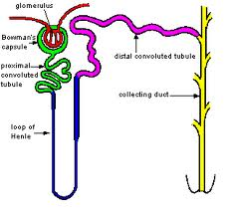
Nephron
Each kidney has 1 million.
They filter the blood,
Then secrete poison, drugs and H⁺ ions for pH balance,
Allow reabsorption the water and salt by the blood
Making urine. Contains Urea from digesting proteins
Uric Acid from digesting nucleic acids.
Creatinine muscle metabolism

Slide 8
Nephron
Structure
Function
Glomerular Capillaries
(Near) (Far)
Proximal/ distal Convoluted renal tubule (Twisted)
Loop of Henle
Collecting ducts
Under high pressure from the arteries the filter out the plasma. (Squeeze the fluid out of the blood through the tiny holes in the capillaries).
This is where glucose, amino acids, water and salt are reabsorbed into the blood stream. Secretes poisons, drugs and H⁺ ions for pH control.
Reabsorbs water and salt NaCl
Carries urine to the Ureters. More water and salt is reabsorbed into the blood here.

Slide 9
Total Body Water Volume 40 liters
Intracellular
Extracellular
Water inside the cell
25 liters
40% of body weight
15 liters 20% of body weight
Interstitial fluid 12 Liters
Blood plasma 3 Liters

Slide 10
Daily Input /output 2500 mls
Daily average input
Daily average output
250 mL Metabolism
750 mL Foods
1500 mL Beverages
100 mL Feces
200 mL sweat
700 mL Lungs and skin
1500 mL Urine

