Slide 1
Why does a cell divide?
To reproduce a sexually (single celled organisms)
To balance the nutrients and waste moving across the cell membrane (big surface area)
To grow
To heal
To specialize into different tissues

Slide 2
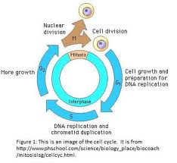
Cell cycle
Most of the cell cycle is used to
Make proteins
Copy DNA
Get ready to divide

Slide 3
Multicellular Organisms
If cells are limited to their size then in order to have large organisms they become multicellular.
Cells specialize into tissues each with a certain job. Nerves for communication and sensing, muscles for moving, digestive system for attaining food etc.
Each of these cells contain all the DNA but to specialize they turn off certain genes and turn on others.

Slide 4
How do cells divide? Mitosis and cytokinesis
Mitosis
How the nucleus divides exactly
Uncoiled DNA copies itself (Chromatin threads)
DNA coils up (Chromosomes)
Centrioles go to each end of the cell
Micro tubules attach to chromosomes
Microtubules pull them apart
Mitosis - YouTube

Slide 5
Phases of mitosis
Interphase works
Prophase coil up
Metaphase line up
Anaphase separate
Telophase uncoil

Slide 6
Cytokinesis
Cytoplasm divides
It doesn’t divide perfectly because it has all the instructions to make extra organelles it needs
At the end of telophase

Slide 7
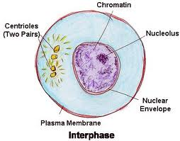
Interphase cell does it’s work

Slide 8
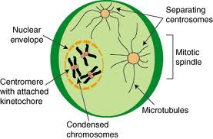
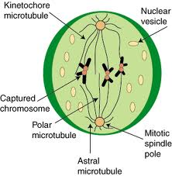
Prophase cell prepares to divide
Early prophase
Late Prophase

Slide 9
Prophase
DNA coils up into Chromosomes
Centrioles migrate to the 2 poles
Aster starts to form
Nuclear envelopes disintegrates
Chromosome are doubled in chromatid pairs.

Slide 10
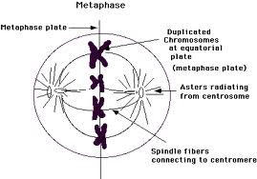
Metaphase Chromosomes line up

Slide 11
Metaphase
Centrioles form a complete spindle
Microtubules attach to the kinetichores of the chromatid pairs
Chromatid Pairs line up across the equator .
Nuclear membrane is gone

Slide 12
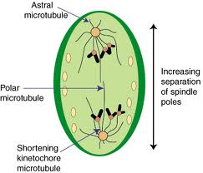
Anaphase the chromotids separate

Slide 13
Anaphase
The micro tubules shorten and pull the chromatids apart.
The chromatids migrate to opposite ends of the cell
The micro tubules push the cell membrane make the cell longer

Slide 14
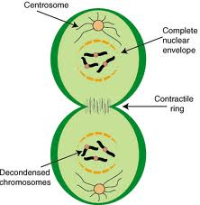
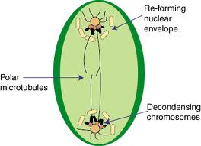
Telophase two new nuclei reform
Early telophase
Late telophase

Slide 15
Telophase
This is prophase backwards
The nuclear envelope reforms.
The chromosomes uncoil
The aster disappears
The cytoplasm starts to divide

Slide 16
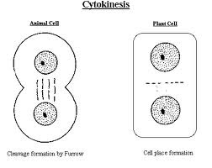
Cytokinesis cytoplasm divides

Slide 17
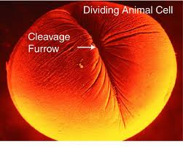
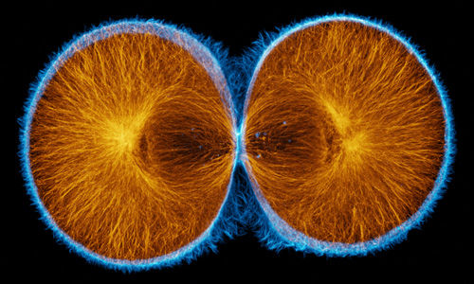
Animal cells make a cleavage furrow

Slide 18
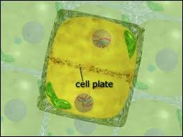
Plant cells make a cell plate

Slide 19
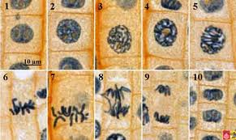
All the stages of mitosis in Allium root tips

