Slide 1
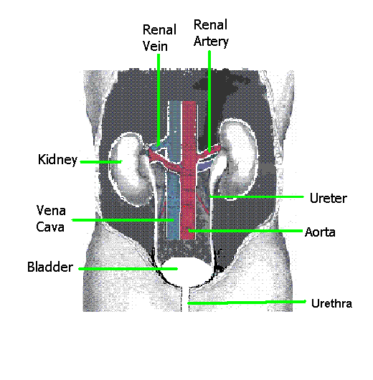
Excretory system

Slide 2
Purpose of excretion
To eliminate wastes.
Wastes to lose are:
Carbon dioxide
Mineral salts, Na, Cl, K,
Nitrogenous wastes from digesting protein, Urea, Uric acid
Water
Heat

Slide 3
Three ways your Body can lose wastes
1. Through your lungs by breathing
Carbon dioxide and water
2. Through the skin by sweating
Water, NaCl, Urea(minimal)
3. Through the urinary tract by peeing
Urea, Uric acid, excess salt, excess water

Slide 4
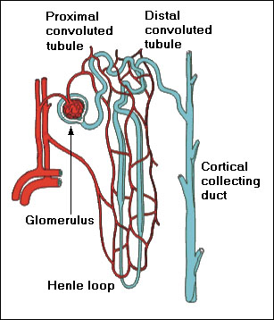
Diagram of nephron
Go to http://www.biologymad.com/resources/kidney.swf

Slide 5
Filter mechanism
Nephrons:
Each kidney has 1,000,000
Bowman’s Capsule filters the blood. It squeezes water, glucose, vitamins, salt, urea, uric acid out of the blood into the nephron.
Loop of Henle reabsorbs any glucose and salt it needs . The water follows the salt by osmosis.

Slide 6
Contents of Urine
Excess Water
Urea
Uric acid
Excess Electrolytes (potassium, sodium, chloride)
Excess vitamins (C, B complex)
Urochrome (Yellow pigment)
Heat
If you have health problems you may have Glucose or Proteins

Slide 7
Homeostasis
This is the control of the body’s internal environment. It needs to be kept relatively steady.
Water- lungs, sweat, kidneys (urine)
Electrolytes (salts)- sweat, urine
Heat- Controlling blood flow to skin, sweating, shivering, urine
Blood sugar- release and storage of glucose controlled by insulin

Slide 8
In Conclusion
We eliminate salt so our cells won’t shrivel and die
We eliminate water so our cells won’t drown
We eliminate CO₂ so our cells don’t asphyxiate
We eliminate urea and uric acid so our cells don’t get poisoned

