Slide 1
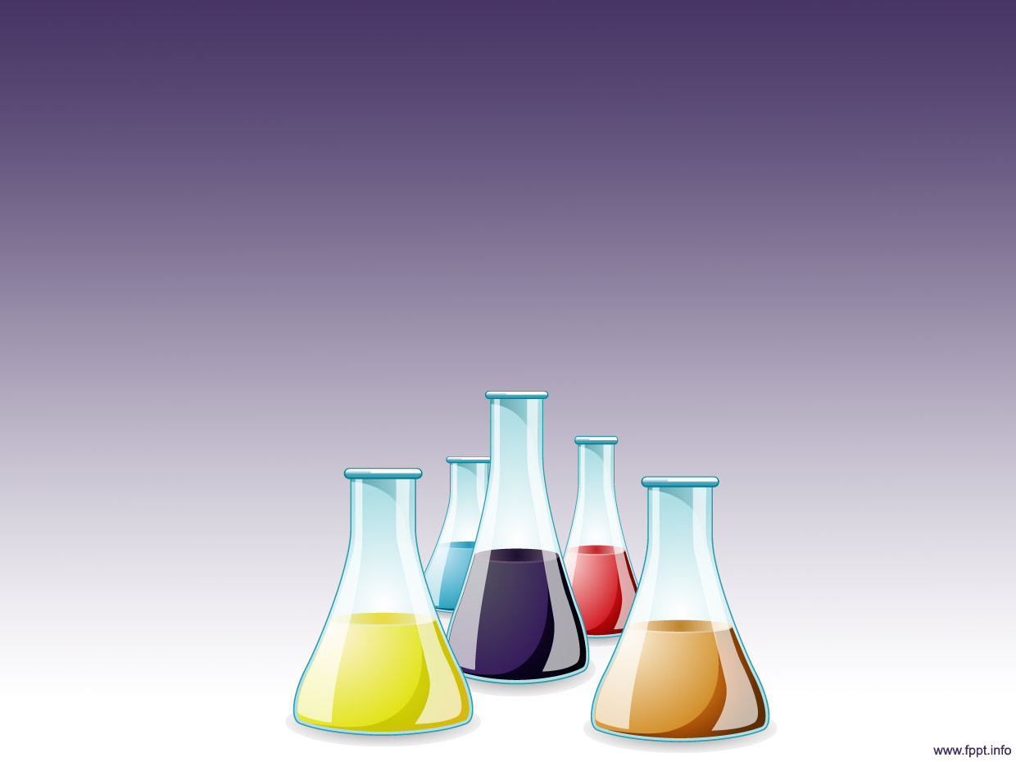
Solutions and Concentration

Slide 2
Materials And Outline
Materials:
Pencil and eraser
Calculator
Goggles
Outline:
Review solutions
What is concentration
More/less concentration
Calculating concentration
Independent/dependent variables

Slide 3
What is a solution?
Homogeneous mixture of solute and solvent
Solute: substance dissolved
Often a solid
Solvent: usually a liquid in which the solute is dissolved
Solution = solute + solvent

Slide 4
Example of a solution
I take a spoonful of Nesquik powder and mix it into my milk to make chocolate milk.
What is the solute?
What is the solvent?
What is the solution?

Slide 5
What is concentration?
The amount of substance within a given volume
C= m/V
C: concentration (g/L)
m: mass of solute (grams)
V: volume of solution (litres)

Slide 6
More/less concentrated
What does it mean when something is more concentrated than something else?
Example

Slide 7
More/less concentrated
1L
Given:
m=8g
V=4L
m=2g
V=1L
Find:
4L
C= m/V
C=8g/4L
C=2g/L
C=2g/1L
C=2g/L

Slide 8
Practice Problem – Calculating Concentration
Emma made herself 50ml of Kool-Aid by dissolving 2.5g of the powder into water. What is the concentration of the Kool-Aid in g/L?
Given:
Find:

Slide 9
Practice Problem – Calculating Concentration
Jeremy is having a party and is making Minute Made juice. He mixes in 100g of the concentrate with some water to produce 2000mL of juice. What is the final concentration (g/L) of the juice?
Given:
Find:
m = 100 g
V = 2000 mL = 2L
C=m/V C = 100g / 2L = 50g/L

Slide 10
Variables
Independent variable:
The variable that is controlled
Dependent variable:
The variable that changes in response to the independent variable

Slide 11
Examples of Variables
You are looking at the effect of mass of solute on the concentration of a solution.
Identify the independent and dependent variables.
Independent variable:
Dependent variable:

