Slide 1
BrainReview

Slide 2
The Nervous System

Slide 3
Nervous System
What is it?
The system that receives, processes, stores and transmits information that comes from various parts of the body and the external world.
Composed of:
The Central Nervous System (CNS)
The Peripheral Nervous System (PNS)

Slide 4
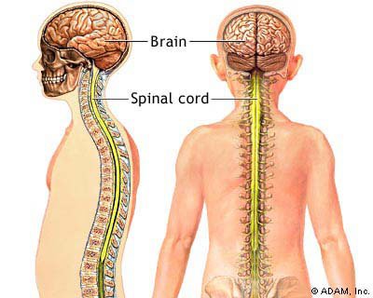
Central Nervous System
Made up of:
the brain
spinal cord

Slide 5
The Brain
The parts of the central nervous system located in the cranium

Slide 6
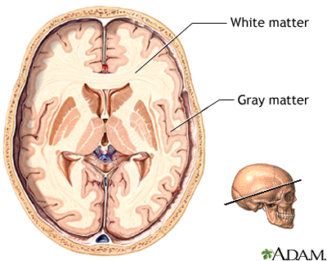
Parts of the Brain
Cerebrum
Grey matter: outer layer
Also called the cerebral cortex
Directs higher brain functions like planning, reasoning and logic
White matter:
inner layer
- Acts as a relay between the different brain regions; coordinates communication

Slide 7
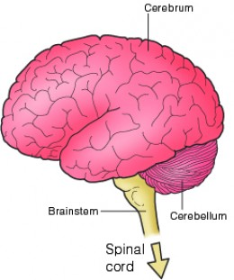
Parts of the Brain
Cerebellum
Coordinates balance
and posture (by contracting appropriate muscles)

Slide 8
Parts of the Brain
Brain stem
Regulate:
breathing
heart rate
communication to
cerebrum

Slide 9
Which way does the ballerina turn?
A
B

Slide 10
A
B
R
L

Slide 11
Left Brain
The left-side of the brain is considered to be adept at tasks that involve logic, language and analytical thinking. The left-brain is often described as being better at:
Language
Logic
Critical thinking
Numbers
Reasoning

Slide 12
Right Brain
According to the left-brain, right-brain dominance theory, the right side of the brain is best at expressive and creative tasks. Some of the abilities that are popularly associated with the right side of the brain include:
Recognizing faces
Expressing emotions
Music
Reading emotions
Colour
Images
Intuition
Creativity

Slide 13
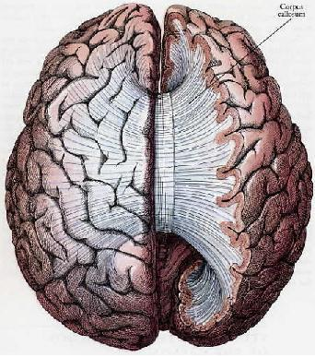
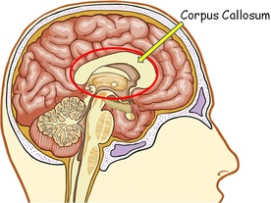
Right Brain vs Left Brain
Our current knowledge
More recent research though has shown that the brain is not quite that simple.
Today neuroscientists know that the two sides of the brain work together to perform a wide variety of tasks and the two sides of the brain communicate through the corpus callosum.

